Slide 1
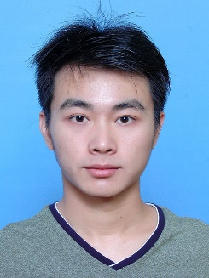
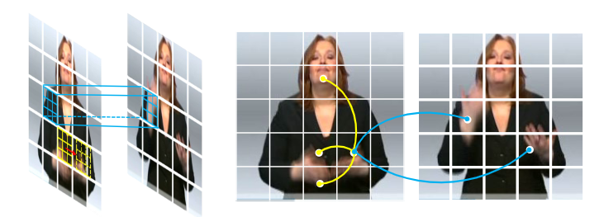
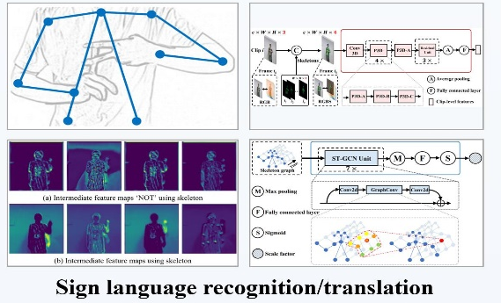
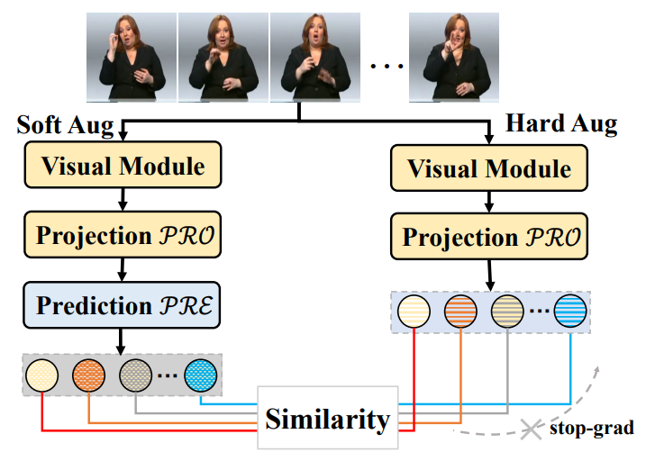
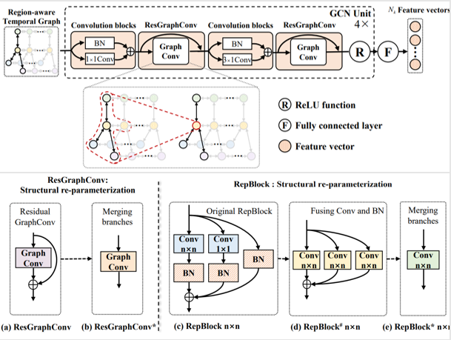
Shiwei Gan
Nanjing University
+86 187-3765-1026
sw@smail.nju.edu.cn
Video-language representation, Sign language recognition and translation
GitHub: https://github.com/gswycf
Education Background
PH.D. 2023.10~2024.10 The University of Warwick Department of Computer Science
Visiting Student Advised by Professor Hongkai Wen
PH.D. 2019.07~2025.06 Nanjing University Department of Computer Science and Technology
Average score: 90.53 Advised by Professor Sanglu Lu and Associate Researcher Yafeng Yin
B.S. 2015.09~ 2019.06 Hunan University College of Computer Science and Electronic Engineering
Average score：87.26 Rank：4/184 （3.26%）
Research
Shiwei Gan，et al. SignGraph: A Sign Sequence is Worth Graphs of Nodes. In CVPR 2024.
Overview： We propose a Skeleton-Aware neural Network for end-to-end SLT by fully exploiting skeletal modality in three aspects: designing a self-contained branch for skeleton extraction, concatenating skeleton and RGB channels for feature extraction, constructing a skeleton-based GCN for feature scaling.
Shiwei Gan, Yafeng Yin, Zhiwei Jiang, Lei Xie, Sanglu Lu. Skeleton-Aware Neural Sign Language Translation. In Proceedings of the 29th ACM International Conference on Multimedia. 2021.
Overview： We propose a Skeleton-Aware neural Network for end-to-end SLT by fully exploiting skeletal modality in three aspects: designing a self-contained branch for skeleton extraction, concatenating skeleton and RGB channels for feature extraction, constructing a skeleton-based GCN for feature scaling.
Shiwei Gan, et al. Contrastive Learning for Sign Language Recognition and Translation. Accepted by IJCAI 2023
Overview：We tackle two widely existing problems in CSLR and SLT: CTC spike phenomenon and the exposure bias problem. We tackle these issues by introducing contrast learning, aiming to enhance both visual-level feature representation and semantic-level error tolerance.
Shiwei Gan, et al. Towards Real-Time Sign Language Recognition and Translation on Edge Devices. Submitted to ACM MM 2023
Selected Honors
Overview：We achieve real-time sign language translation without GPU by designing a lightweight region aware temporal GCN and adopting structural re-parameterization.
2021.12 Outstanding Graduate Student of Nanjing University
2021.11 Guorui Scholarship in Nanjing university (4 out of whole department)
2019-2022 First Prize of Academic Scholarship for three consecutive years in Nanjing university
2015-2018 The national inspirational scholarship for three consecutive years in Hunan University
2015-2017 Miyoshi students for two consecutive years in Hunan University
2018.04 First prize of Hunan university ACM
2018.04 Bronze medal in Hubei Province ACM
Skills, Activities and Advantages
CET-4：525，CET-6：498, IELTS: 7.0 (Listening:6.5, Reading: 8.5, Writing: 6.0, Speaking: 6.0)
CCF Certified Software Professional： 360（1%）
Teaching Assistant at Nanjing University: Data Structure, Fall 2020-2022
Hardworking, Highly motivated

Slide 2
Shiwei Gan
Nanjing University
+86 187-3765-1026
sw@smail.nju.edu.cn
Video-language representation, Sign language recognition and translation
GitHub: https://github.com/gswycf
Education Background
PH.D. 2023.10~2024.10 The University of Warwick Department of Computer Science
Visiting Student Advised by Professor Hongkai Wen
PH.D. 2019.07~2025.06 Nanjing University Department of Computer Science and Technology
Average score: 90.53 Advised by Professor Sanglu Lu and Associate Researcher Yafeng Yin
B.S. 2015.09~ 2019.06 Hunan University College of Computer Science and Electronic Engineering
Average score：87.26 Rank：4/184 （3.26%）
Research
Shiwei Gan, Yafeng Yin, Zhiwei Jiang, Hongkai Wen, Lei Xie, Sanglu Lu. SignGraph: A Sign Sequence is Worth Graphs of Nodes. In CVPR 2024. CCF-A
Kang Xia, Wenzhong Li, Shiwei Gan, Sanglu Lu. TS2ACT: Few-Shot Human Activity Sensing with Cross-Modal Co-Learning. In Proceedings of the ACM on Interactive, Mobile, Wearable and Ubiquitous Technologies 2024. CCF-A
Shiwei Gan, Yafeng Yin, Zhiwei Jiang, Lei Xie, Sanglu Lu. Contrastive Learning for Sign Language Recognition and Translation. In IJCAI 2023
Shiwei Gan, Yafeng Yin, Zhiwei Jiang, Lei Xie, Sanglu Lu. Towards Real-Time Sign Language Recognition and Translation on Edge Devices. In ACM MM 2023 CCF-A
Shiwei Gan, Yafeng Yin, Zhiwei Jiang, Lei Xie, Sanglu Lu. Skeleton-Aware Neural Sign Language Translation. In ACM MM 2021. CCF-A
Shiwei Gan, Yafeng Yin, Zhiwei Jiang, Lei Xie, Sanglu Lu. Skeleton-Aware Neural Sign Language Translation. In ACM MM 2021. CCF-A
Selected Honors
2021.12 Outstanding Graduate Student of Nanjing University
2021.11 Guorui Scholarship in Nanjing university (4 out of whole department)
2019-2022 First Prize of Academic Scholarship for three consecutive years in Nanjing university
2015-2018 The national inspirational scholarship for three consecutive years in Hunan University
2015-2017 Miyoshi students for two consecutive years in Hunan University
2018.04 First prize of Hunan university ACM
2018.04 Bronze medal in Hubei Province ACM
Skills, Activities and Advantages
IELTS: 7.0 (Listening:6.5, Reading: 8.5, Writing: 6.0, Speaking: 6.0
CCF Certified Software Professional： 360（1%）
Teaching Assistant at Nanjing University: Data Structure, Fall 2020-2022
Teaching Assistant at the University of Warwick: CS933-15 Image and Video Analysis, Fall 2023
Support Invigilator at the University of Warwick, May, 2024
Notes:
入学时间：2019.07主要科研成果：已发表4篇A会一作（JICAI，MM，MM，CVPR），一篇A会3作（Ubicomp），一篇B期刊（JCST）在投，一篇A会在投（MM）
2个专利，学生一作学生参与项目时间:2022-01-01，项目名称:移动设备上基于多模态感知的行为识别技术研究获得的奖励荣誉：2021年南京大学优秀研究生，2023年南京大学优秀研究生，2023华为奖学金，2021中国电科十四所国睿奖学金

Slide 3
Shiwei Gan
Nanjing University
+86 187-3765-1026
sw@smail.nju.edu.cn
Video-language representation, Sign language recognition and translation
GitHub: https://github.com/gswycf
Education Background
PH.D. 2023.10~2024.10 The University of Warwick Department of Computer Science
Visiting student sponsored by CSC Scholarship Advised by Professor Hongkai Wen
PH.D. 2019.07~2025.06 Nanjing University Department of Computer Science and Technology
Average score: 90.53 Advised by Professor Sanglu Lu and Associate Researcher Yafeng Yin
B.S. 2015.09~ 2019.06 Hunan University College of Computer Science and Electronic Engineering
Average score：87.26 Rank：4/184 （3.26%）
Research
Shiwei Gan, Yafeng Yin, Zhiwei Jiang, Hongkai Wen, Lei Xie, Sanglu Lu. SignGraph: A Sign Sequence is Worth Graphs of Nodes. In CVPR 2024.
CCF-A conference
Kang Xia, Wenzhong Li, Shiwei Gan, Sanglu Lu. TS2ACT: Few-Shot Human Activity Sensing with Cross-Modal Co-Learning. In Proceedings of the ACM on Interactive, Mobile, Wearable and Ubiquitous Technologies 2024.
Shiwei Gan, Yafeng Yin, Zhiwei Jiang, Lei Xie, Sanglu Lu. Contrastive Learning for Sign Language Recognition and Translation. In IJCAI 2023.
Shiwei Gan, Yafeng Yin, Zhiwei Jiang, Lei Xie, Sanglu Lu. Towards Real-Time Sign Language Recognition and Translation on Edge Devices. In ACM MM 2023.
Shiwei Gan, Yafeng Yin, Zhiwei Jiang, Lei Xie, Sanglu Lu. Skeleton-Aware Neural Sign Language Translation. In ACM MM 2021.
Paten:
Yafeng Yin, Shiwei Gan, Lei Xie, Sanglu Lu. A real-time sign language recognition and translation system and method based on edge devices. Application Publication Number: CN117218725A
Yafeng Yin, Shiwei Gan, Lei Xie, Sanglu Lu. A Sign Language Recognition System and Method Based on Spatiotemporal Semantic Features. Application Publication Number: CN111797777A
Selected Honors
Huawei Scholarship in Nanjing university （ 7out of whole department ） 2023
Outstanding Graduate Student for two years in Nanjing University 2021，2023
Guorui Scholarship in Nanjing university (4 out of whole department) 2023
First Prize of Academic Scholarship for four consecutive years in Nanjing university 2019-2024
The national inspirational scholarship for three consecutive years in Hunan University 2015-2018
Miyoshi students for two consecutive years in Hunan University 2015-2017
Bronze medal in Hubei Province ACM 2018.04
Skills, Activities
IELTS: 7.0 (Listening:6.5, Reading: 8.5, Writing: 6.0, Speaking: 6.0
CCF Certified Software Professional： 360（Top 1%）
Teaching Assistant at Nanjing University: Data Structure, Fall 2020-2022
Teaching Assistant at the University of Warwick: CS933-15 Image and Video Analysis, Fall 2023
Support Invigilator at the University of Warwick, May, 2024

